Slide 1
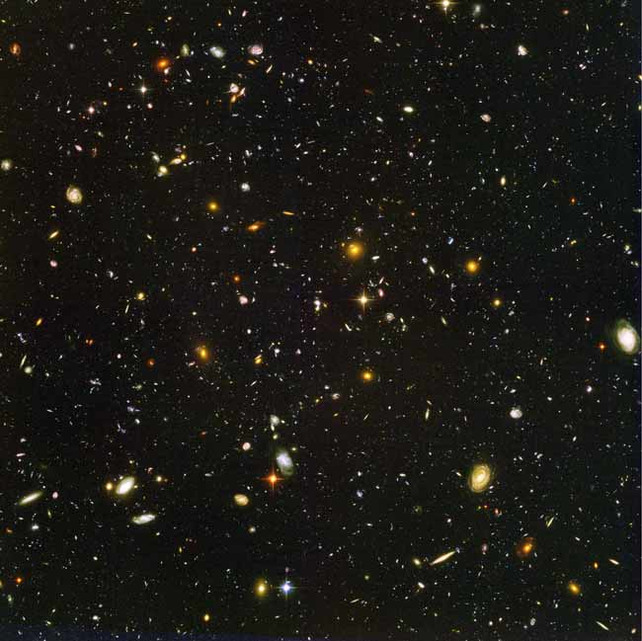
Current Mysteries of the Universe
Endless mysteries lurk in the depths of space, therefore, only a few are explored here. This selection of 8 mysteries spans the entire history of the universe on scales ranging from our sun and its planetary system to the entire cosmos.
1. What is Dark Energy?
2. How Hot is Dark Matter?
3. Where Are the Missing Baryons?
4. How Do Stars Explode?
Click on a mystery to begin.
5. What Reionized the Universe?
?
6. What’s the Source of the Most Energetic Cosmic Rays?
7. Why Is the Solar System So Bizarre?
8. Why Is the Sun’s Corona So Hot?

Slide 2
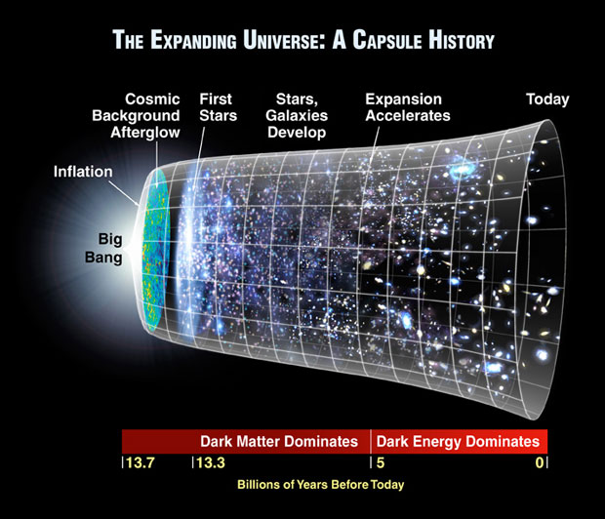
1. What Is Dark Energy?
In 1998 astronomers studied distant supernovas with the Hubble Space Telescope. They discovered that the expansion rate of the universe is increasing.
Previously, it was thought that gravity would slow the expansion rate or perhaps even cause the universe to contract.
Next Mystery

Slide 3
1. What Is Dark Energy?
Astronomers were unable to identify what was causing this increasing expansion rate, so they named this unknown force “dark energy.”
Currently dark energy makes up approximately 72% of the universe.
Next Mystery

Slide 4
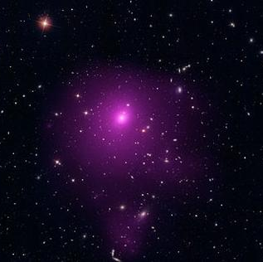
1. What Is Dark Energy?
The Blanco Telescope in Chile, which will conduct the Dark Energy Survey, silhouetted against the Milky Way
So what could this dark energy be? Scientists have three ideas.
a property of empty space itself (like Einstein’s cosmological constant in general relativity)
a new type of force field that occupies space, much as air fills a balloon
an illusion, a sign that scientists’ understanding of gravity isn’t quite right yet
The galaxy cluster Abell 85 is one of the objects used to study the effects of dark energy on the evolution of large structures in the universe.
Next Mystery

Slide 5
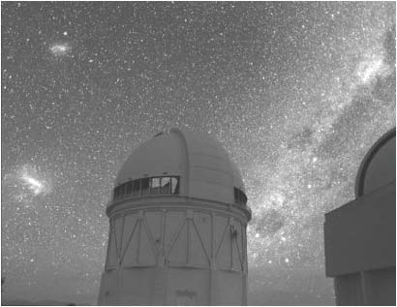
1. What Is Dark Energy?
The Blanco Telescope in Chile, which will conduct the Dark Energy Survey, silhouetted against the Milky Way
Researchers working with the Dark Energy Survey at the Cerro Tololo Inter-American Observatory in Chile hope to study 200-300 million galaxies, 100,000 galaxy clusters, and 4000 supernovae.
The information collected will help them to more precisely reconstruct the history of the universe’s expansion. This in turn will help the researchers detect dark energy’s effects on the formation of the largest structures in the universe. The results will allow scientists to calculate dark energy’s equation of state (and therefore what it is).
The Blanco Telescope in Chile, which will conduct the Dark Energy Survey, silhouetted against the Milky Way.
Next Mystery

Slide 6
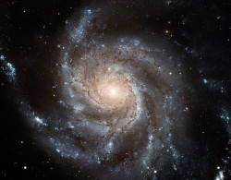
2. How Hot is Dark Matter?
Vera Rubin studied the speeds of stars at various distances from the centers of galaxies.
She expected that the rotation rate would remain fairly constant until she reached the visible edge of the galaxy. At that point the stars should orbit more slowly the farther you go out. (Just like planets further from the sun take longer to orbit than those closer.)
Previous Mystery
Next Mystery

Slide 7
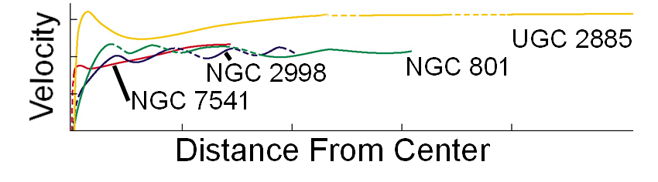
2. How Hot is Dark Matter?
She noticed that the velocities of the stars did not drop off as expected. This means that there is unseen matter beyond the edge of the galaxy.
Previous Mystery
Next Mystery

Slide 8
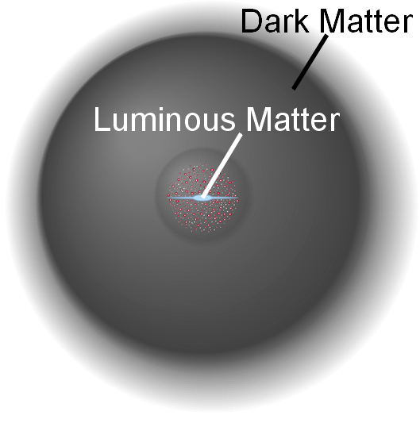
2. How Hot is Dark Matter?
Astronomers call this “invisible” matter: dark matter.
Within a galaxy there is ten times more dark matter than visible matter.
Dark matter makes up 23% of the universe.
Previous Mystery
Next Mystery

Slide 9
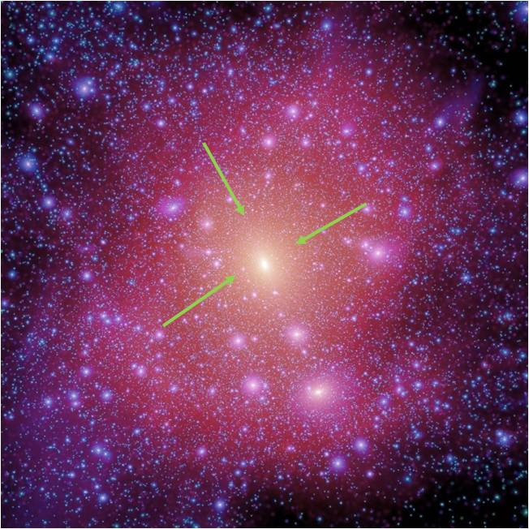
2. How Hot is Dark Matter?
Studies of dwarf galaxies might test whether dark matter is icy cold as theory assumes, or somewhat warmer.
These tests in turn answer how massive dark matter particles are: the colder they are, the more massive they are.
A simulation showing the dark matter halo (pink) surrounding a galaxy the size of the Milky Way (arrows).
Previous Mystery
Next Mystery

Slide 10
3. Where Are the Missing Baryons?
To describe the universe, astronomers need to know what it is made of. Dark matter and dark energy (whatever they turn out to be) make up 95% of the universe.
From observations of the cosmic background radiation, scientists know the remaining 5% is baryonic matter; so called since its main ingredients, protons and neutrons, are members of a class of particles called baryons.
Previous Mystery
Next Mystery

Slide 11
3. Where Are the Missing Baryons?
By looking at masses of nearby stars, galaxies, gas, etc. astronomers can calculate the number of baryons in the universe today. However when they compare the number of baryons found in the early universe to the number in the universe today, it appears half of them have disappeared.
Since they simple can’t vanish, the question is where are they “hiding?”
Previous Mystery
Next Mystery

Slide 12
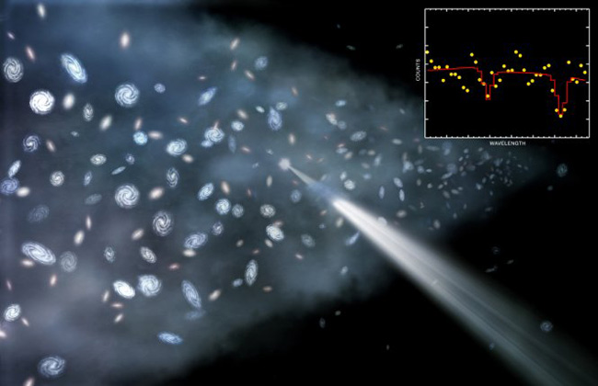
3. Where Are the Missing Baryons?
Astronomers believe that they are “hiding” in a hot diffuse plasma between galaxies. This hot diffuse plasma consists of particles such as protons, neutrons, atomic ions, and so on that are moving very fast and are on the order of one meter apart. (For comparison, the particles in our atmosphere are one hundred millionths of a meter apart.)
Artist’s conception shows how astronomers have detected warm intergalactic gas by studying its effect of x-ray light from distant quasars.
Previous Mystery
Next Mystery

Slide 13
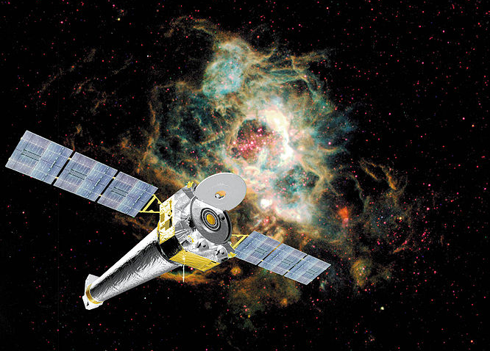
3. Where Are the Missing Baryons?
Although these particles are difficult to detect, astronomers are searching for particular ions of neon and oxygen which, if found, would show that this plasma exists.
Some astronomers believe they have found evidence for these particles, but other astronomers are not convinced.
Scientists hope they will find the neon and oxygen ions through the x-ray observations of the Chandra telescope shown here.
Previous Mystery
Next Mystery

Slide 14
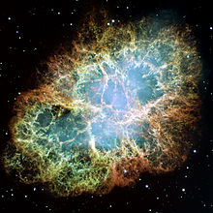
4. How Do Stars Explode?
Astronomers have known for a long time that when massive stars reach the end of their lives, they undergo a supernova explosion.
This explosion blows the outer layers of the star into space. The central regions of the star become either a black hole or neutron star.
The Crab nebula, shown above is the result of a supernova explosion which occurred in the year 1066. Astronomers have discovered a pulsar or neutron star at the center of the gas cloud.
Previous Mystery
Next Mystery

Slide 15
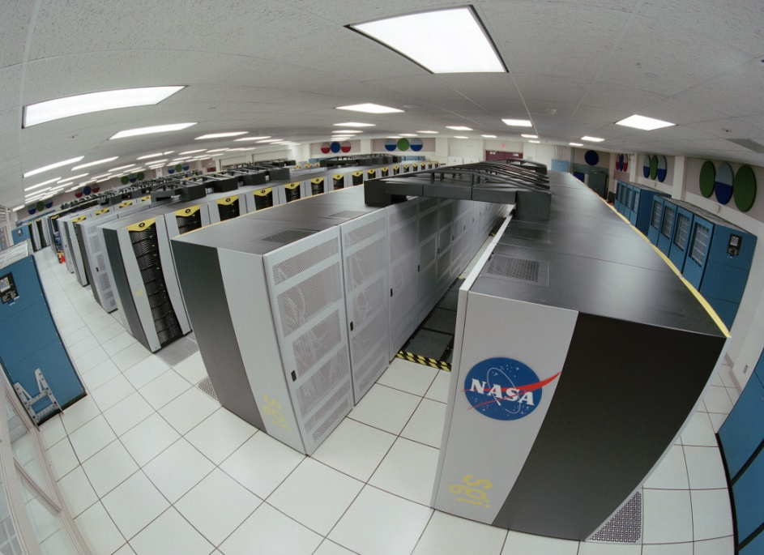
4. How Do Stars Explode?
In recent years, advances in supercomputing have enabled astronomers to simulate the internal conditions of stars with increasing sophistication, helping them to better understand the details of these stellar explosions.
This is one example of a supercomputer.
Previous Mystery
Next Mystery

Slide 16
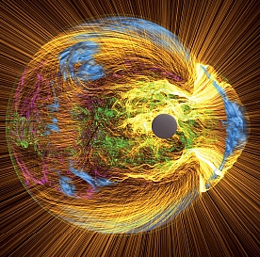
4. How Do Stars Explode?
Yet, many details of what goes on inside a star leading up to an explosion, as well as how that explosion unfolds, remain a mystery.
Astronomers seek to understand exactly how shock waves from the core of a star blow out its outer shells in a brilliant supernova, as shown in this computer-generated visualization.
Previous Mystery
Next Mystery

Slide 17
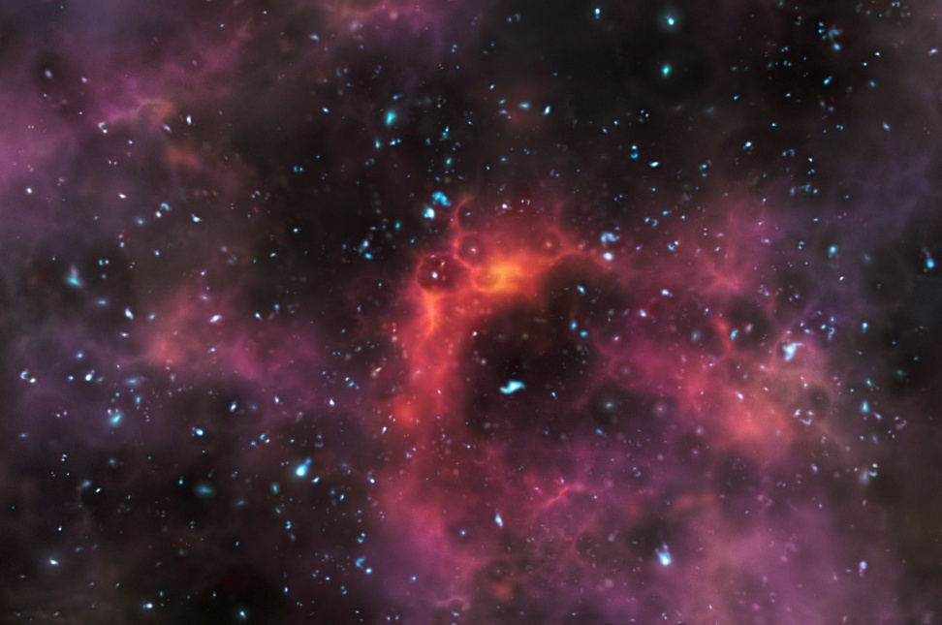
5. What Reionized the Universe?
The big bang theory of the origin of the universe states that the cosmos began as an incredibly hot, dense point roughly 13.7 billion years ago.
Out of this explosion protons, neutrons, electrons, and other particles formed.
This artist’s impression shows galaxies at a time less than a billion years after the big bang, when the universe was still partially filled with hydrogen fog that absorbed ultraviolet light.
Previous Mystery
Next Mystery

Slide 18
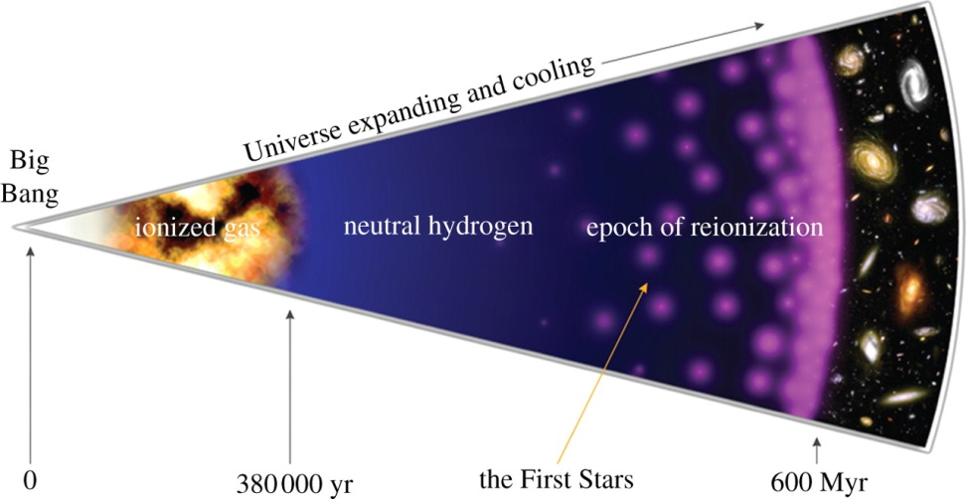
5. What Reionized the Universe?
For the first 400 thousand years, particles of light, called photons, were constantly scattered by the free electrons. After 400,000 years the universe cooled enough for electrons to combine with protons to form neutral hydrogen atoms.
Once this occurred, electrons could no longer scatter photons and the universe became transparent to light.
Previous Mystery
Next Mystery

Slide 19
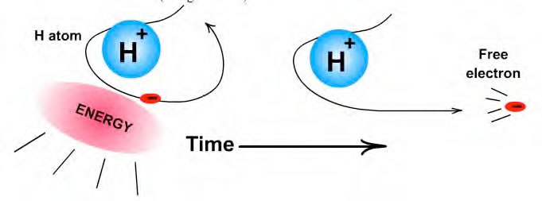
5. What Reionized the Universe?
A few hundred million years later, electrons were stripped off hydrogen atoms. (This process is referred to as ionization.) As a result, light was again scattered by electrons and the universe once again became opaque to light.
The question is what stripped the electrons from the atoms. This is referred to as reionizing the universe.
Ionization
Previous Mystery
Next Mystery

Slide 20

5. What Reionized the Universe?
However this time, the resultant “particle soup” was relatively dilute. This meant that most photons could pass through it unimpeded and it was nearly impossible for the particles to recombine into atoms.
As a result, most of the universe’s matter turned into the light-transmitting ionized plasma that it remains today.
The Low Frequency Array in the Netherlands is searching for signs of the neutral hydrogen that vanished from the universe almost 13 billion years ago.
Previous Mystery
Next Mystery

Slide 21
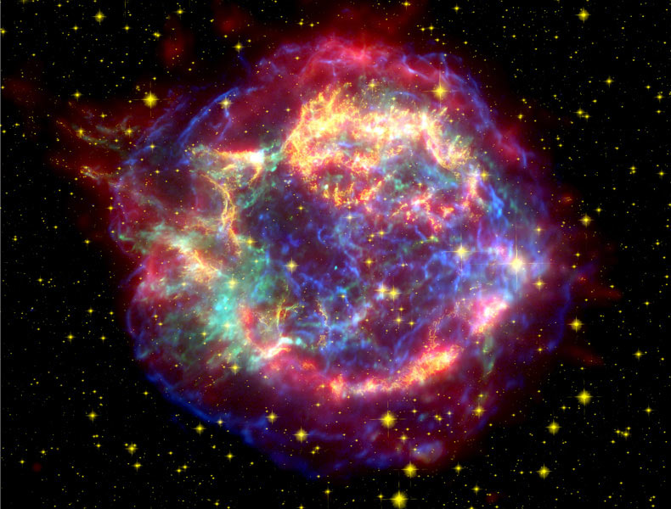
6. What’s the Source of the Most Energetic Cosmic Rays?
Cosmic rays are charged particles (mostly protons and helium nuclei) that impact Earth from outer space.
Low energy cosmic rays come from the sun and medium energy cosmic rays come from supernova explosions in our galaxy.
The mystery is where do the very high energy cosmic rays originate.
This is a supernova remnant of Cassiopeia A. Medium energy cosmic rays come from supernova explosions such as the one that occurred here.
Previous Mystery
Next Mystery

Slide 22
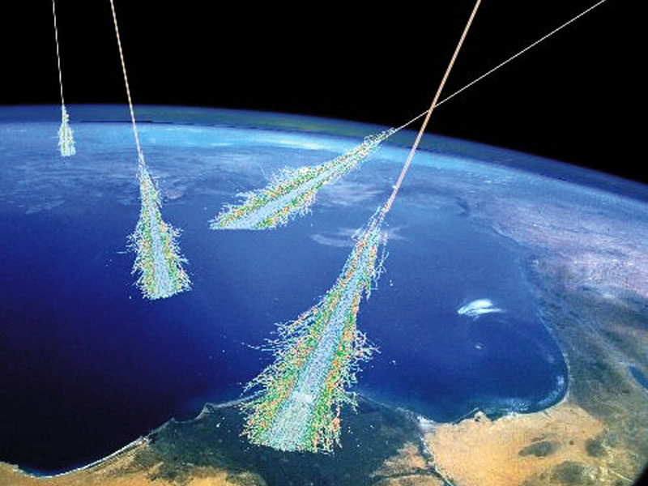
6. What’s the Source of the Most Energetic Cosmic Rays?
An example of one of these very high energy cosmic rays is a proton traveling barely under the speed of light and containing as much energy as a baseball traveling 60 miles per hour.
A simulation of air showers of cosmic rays hitting Earth.
Previous Mystery
Next Mystery

Slide 23
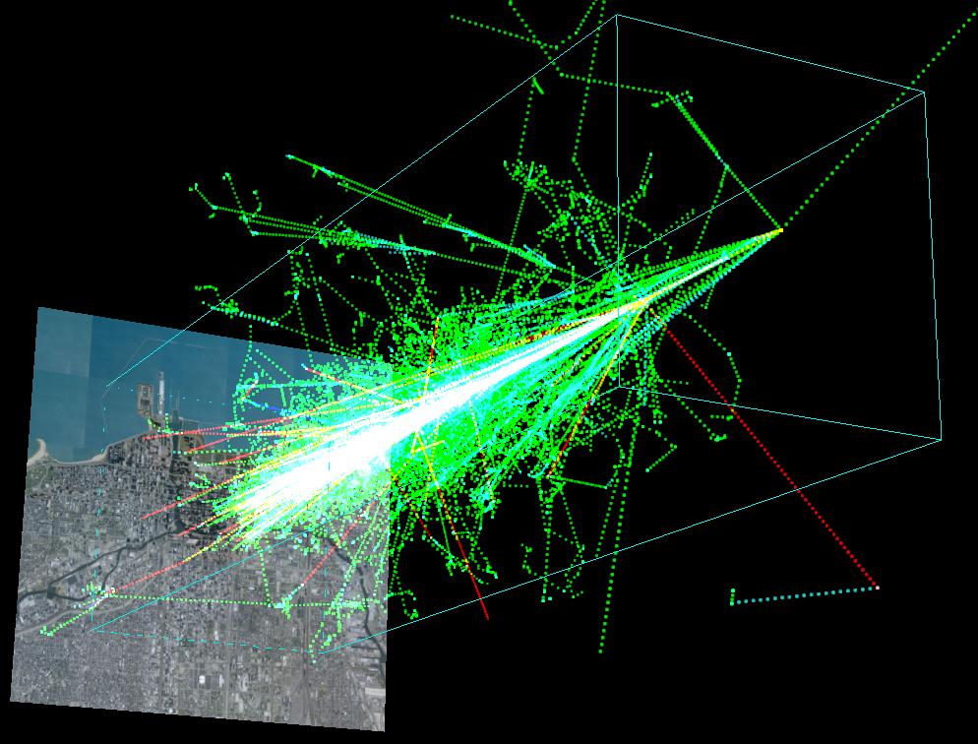
6. What’s the Source of the Most Energetic Cosmic Rays?
Cosmic rays are indirectly detected by observing the shower of particles created when the cosmic ray hits atomic nuclei in Earth’s upper atmosphere.
Since the path of the particle shower follows the path of the original cosmic ray, the rays original direction can be determined.
A simulation of an air shower caused by a 10¹² eV proton hitting the atmosphere 20 kilometers above Chicago’s lakefront.
Previous Mystery
Next Mystery

Slide 24
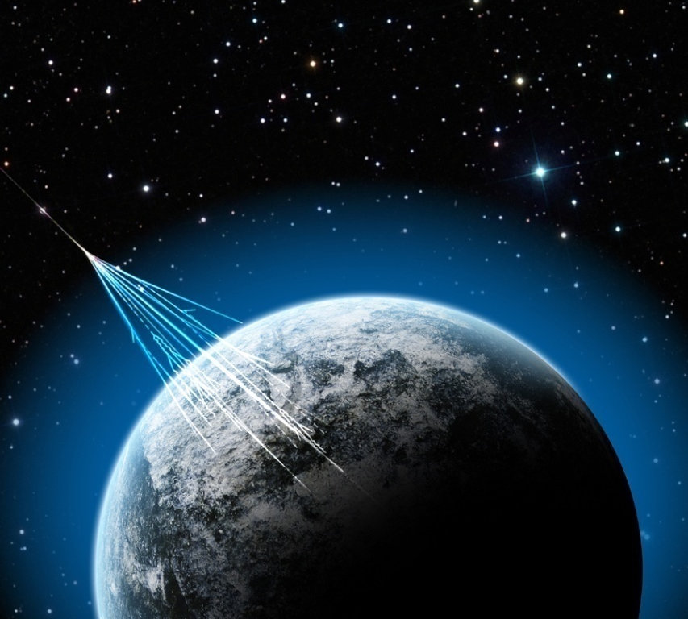
6. What’s the Source of the Most Energetic Cosmic Rays?
Although astronomers know that these high energy cosmic rays originate outside our galaxy, their exact source remains a mystery.
Little is know about the ultra high-energy cosmic rays that regularly penetrate the atmosphere.
Previous Mystery
Next Mystery

Slide 25
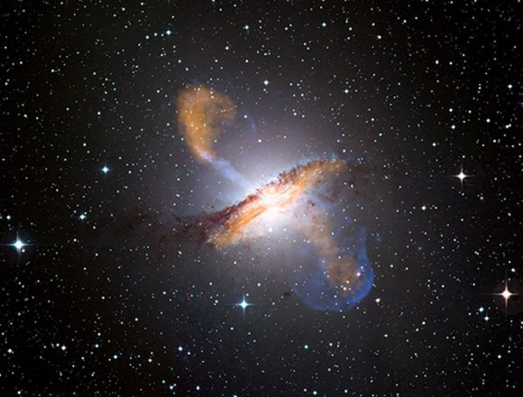
6. What’s the Source of the Most Energetic Cosmic Rays?
Scientists theorize that they originate in:
hot spots in energetic radio galaxies
gamma ray bursts
jets streaming from supermassive black holes at the heart of active galactic nuclei
There are many candidates for the origin of ultrahigh-energy cosmic rays, but recent results from the Pierre Auger Observatory point to the jets emanating from active galactic nuclei such as Centaurus A.
Previous Mystery
Next Mystery

Slide 26
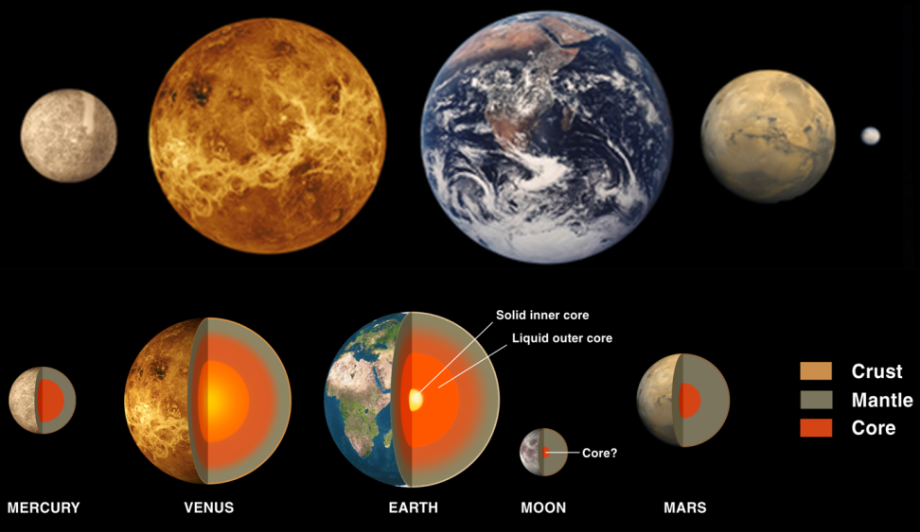
7. Why Is the Solar System So Bizarre?
The 4 innermost planets all have rocky outer shells and metallic cores. However on closer inspection there are notable differences.
Mercury’s iron core is larger than expected.
Only Earth has crustal plates.
Earth has a magnetic field; Venus does not.
Previous Mystery
Next Mystery

Slide 27
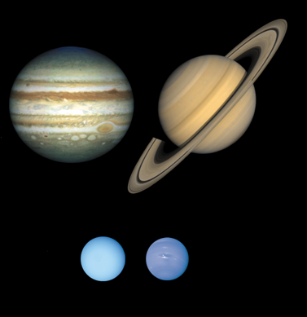
7. Why Is the Solar System So Bizarre?
The 4 outer planets also have similarities -- rings; cores of metal and rock; and large numbers of moons. However they also have significant differences.
Jupiter has four large moons, Saturn just one.
Uranus and Neptune could not have formed at their current locations -- there would not have been enough material.
Both Neptune’s and Uranus’s magnetic field axes are tilted significantly away from their rotation axes.
Previous Mystery
Next Mystery

Slide 28
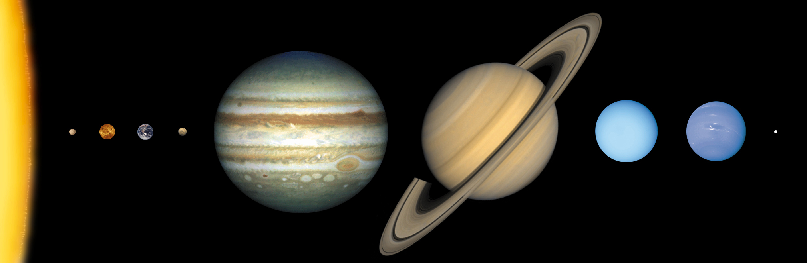
7. Why Is the Solar System So Bizarre?
The search for alien worlds could help scientist gain insights into the planets in our solar system.
Patterns may emerge that explain the diversity of our own planets or confirm that it is a result of random chance.
Previous Mystery
Next Mystery

Slide 29
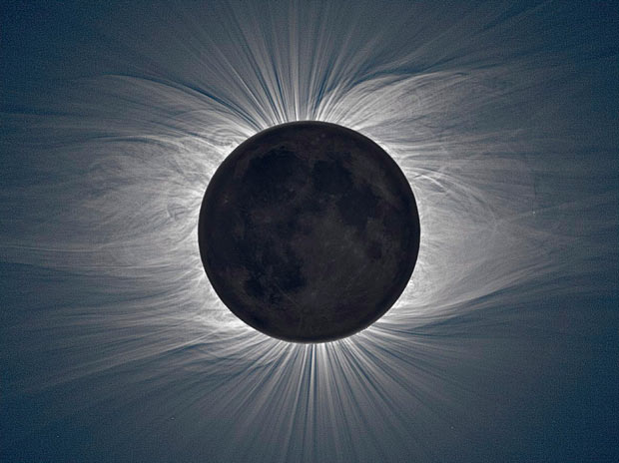
8. Why Is the Sun’s Corona So Hot?
The corona is the ultra-hot outer atmosphere of the sun.
The corona’s temperature ranges from 900,000 degrees Fahrenheit to 10.8 million.
Solar physicists are mystified by the sun’s ability to reheat its corona.
The sun’s corona reveals itself during a total solar eclipse as the moon passes in front of the visible surface of the sun. Here the moon is visible by Earth light.
Previous Mystery

Slide 30
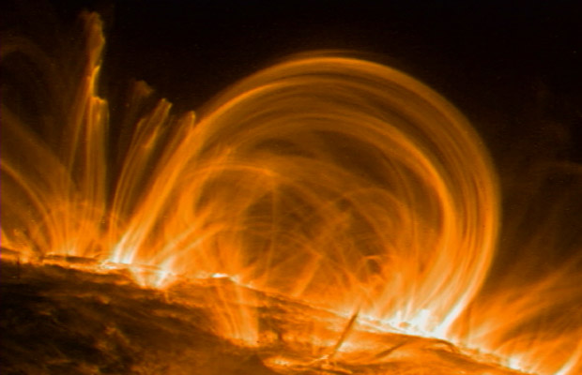
8. Why Is the Sun’s Corona So Hot?
The solar physicists agree:
there is plenty of energy to heat the corona in the sun’s interior.
the sun’s magnetic field carries the required energy outward to the corona.
They wonder:
How does the magnetic field transport the energy?
How does the energy get deposited once it reaches the corona?
These are coronal loops made of glowing plasma (like magnetized gas). Magnetic fields from the Sun shape the plasma into the loops shown.
Previous Mystery

Slide 31
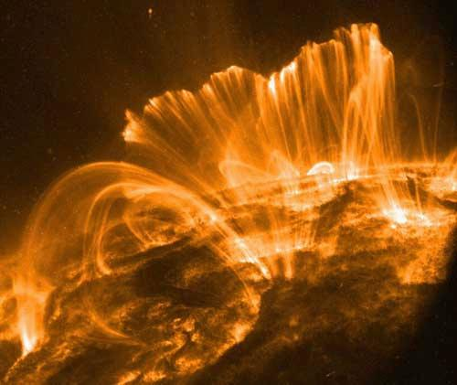
8. Why Is the Sun’s Corona So Hot?
Popular candidates for explaining this are:
heating by magnetic waves
“nanoflares” heating the corona which are produced when magnetic field lines snap and reconnect
These are more coronal loops.
Previous Mystery

